Slide 1
SlicerIGT tutorial 2017
brain surgery navigation with live tractography

Slide 2
Prerequisites
This tutorial can be completed without any previous tutorials, but the following tutorials are recommended before this one
Slicer4 Minute Tutorial from https://www.slicer.org/wiki/Documentation/4.8/Training
SlicerIGT tutorials from http://www.slicerigt.org/wp/user-tutorial/

Slide 3
Install Slicer
Visit http://download.slicer.org/
Download Slicer version 4.8 (blue buttons) for your operating system
Run the downloaded installer
Start up Slicer
1

Slide 4
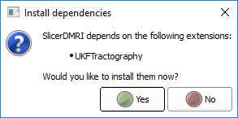
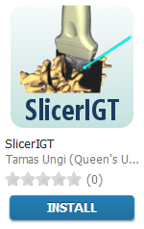
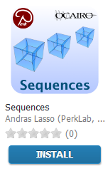
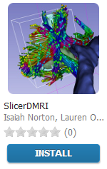
Install Slicer extensions
1. click
2. Find and install these extensions: SlicerIGT, Sequences, SlicerDMRI
6. click
3. click
4. click
5. click
7. click

Slide 5
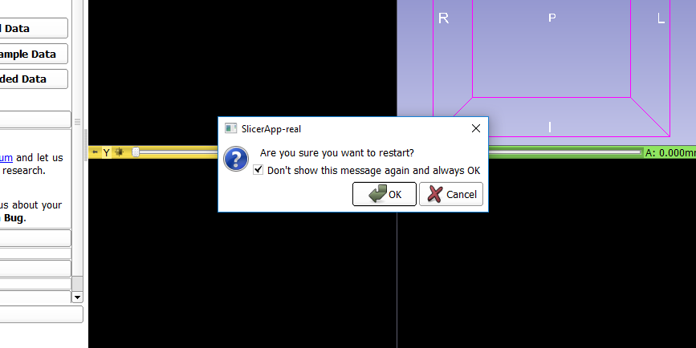
Approve restart of Slicer (if asked)
1. check
2. click

Slide 6
Verify extensions installed

Slide 7
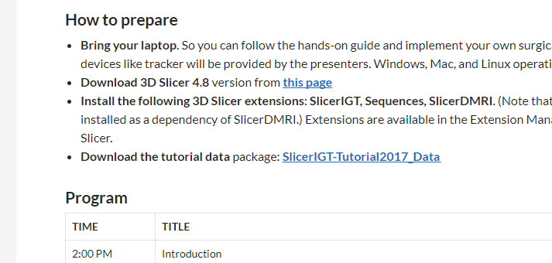
Download tutorial data
Visit the tutorial website: http://www.slicerigt.org/wp/smit-2017-tutorial/
Download the tutorial data ZIP file
Unzip the contents (e.g. in your home folder)

Slide 8
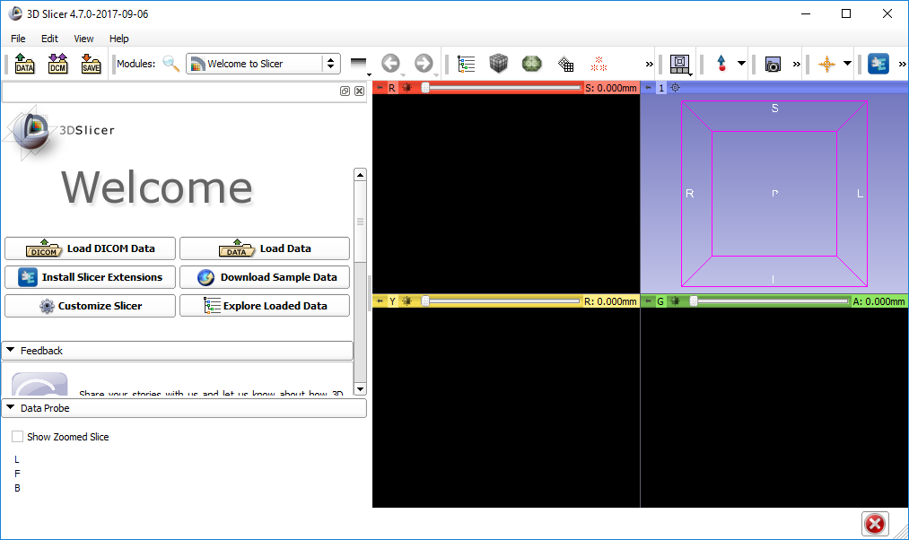
Open dialog

Slide 9
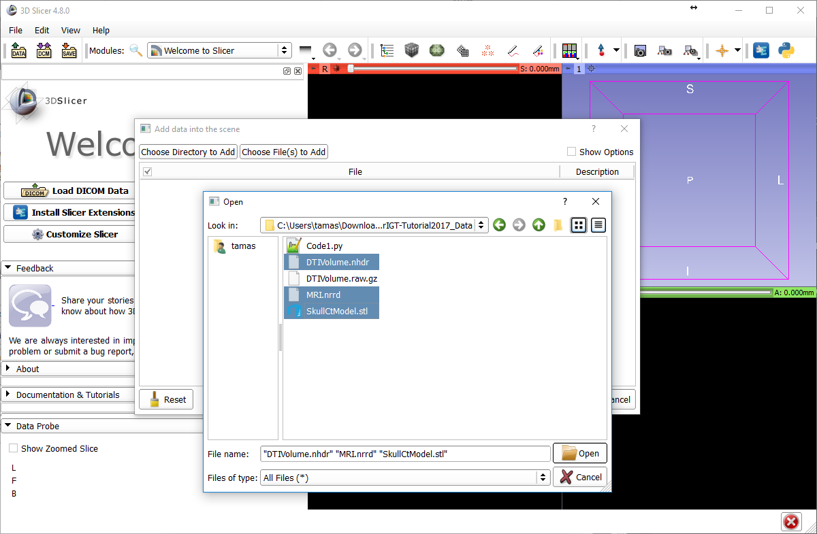
1
2
2
2
3

Slide 10
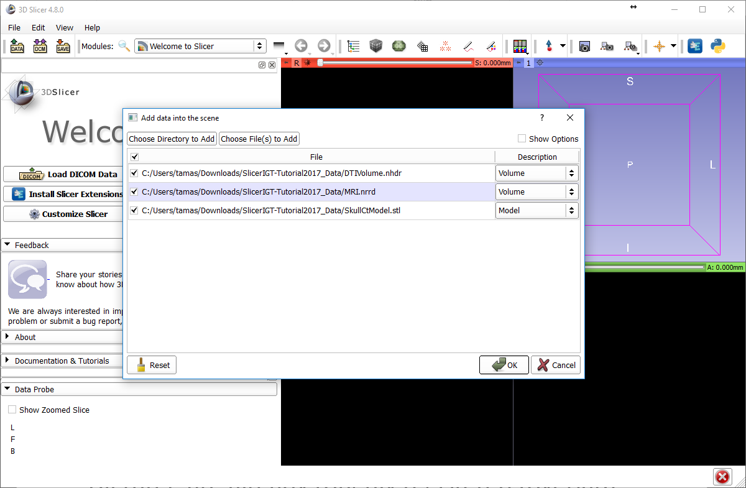
1

Slide 11
About the loaded data
SkullCtModel.stl: Segmentation from CT scan of the plastic skull model
loaded as model
MRI.nrrd: Magnetic resonance image of a person. (not the same one the plastic model was based on)
loaded as a scalar volume
DTIVolume.nhdr: Diffusion tensor image (from a third person)
loaded as a tensor volume
All three are already roughly registered (overlap)

Slide 12
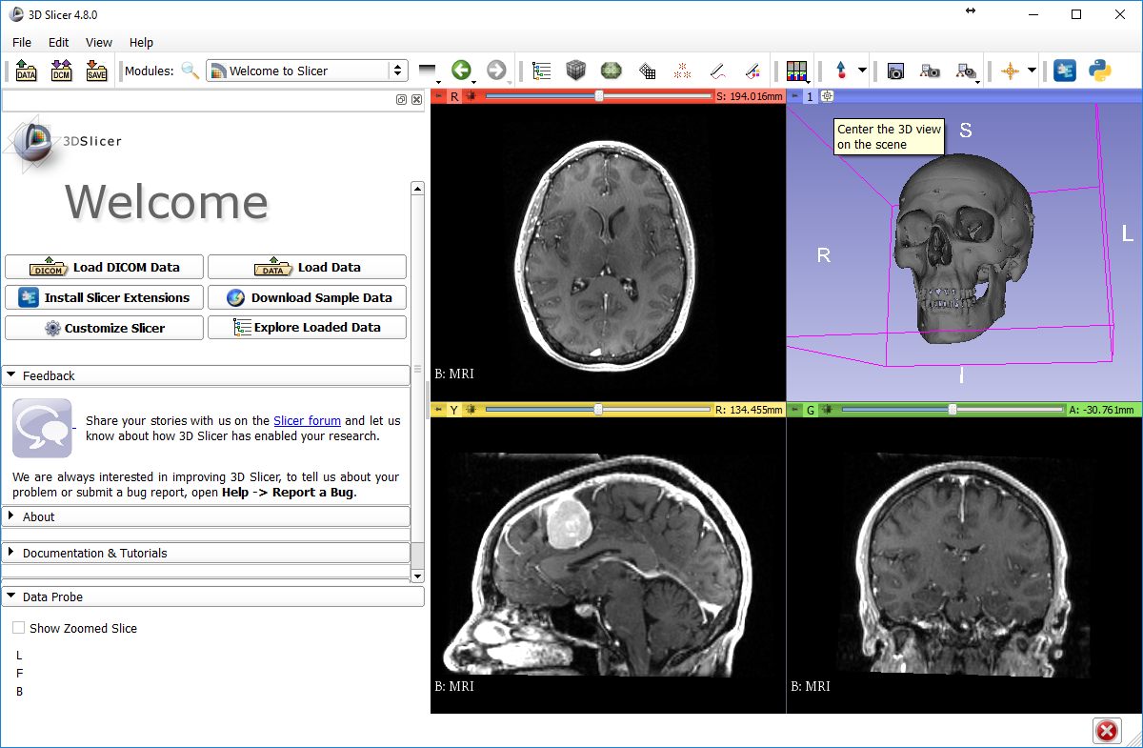
1
2

Slide 13
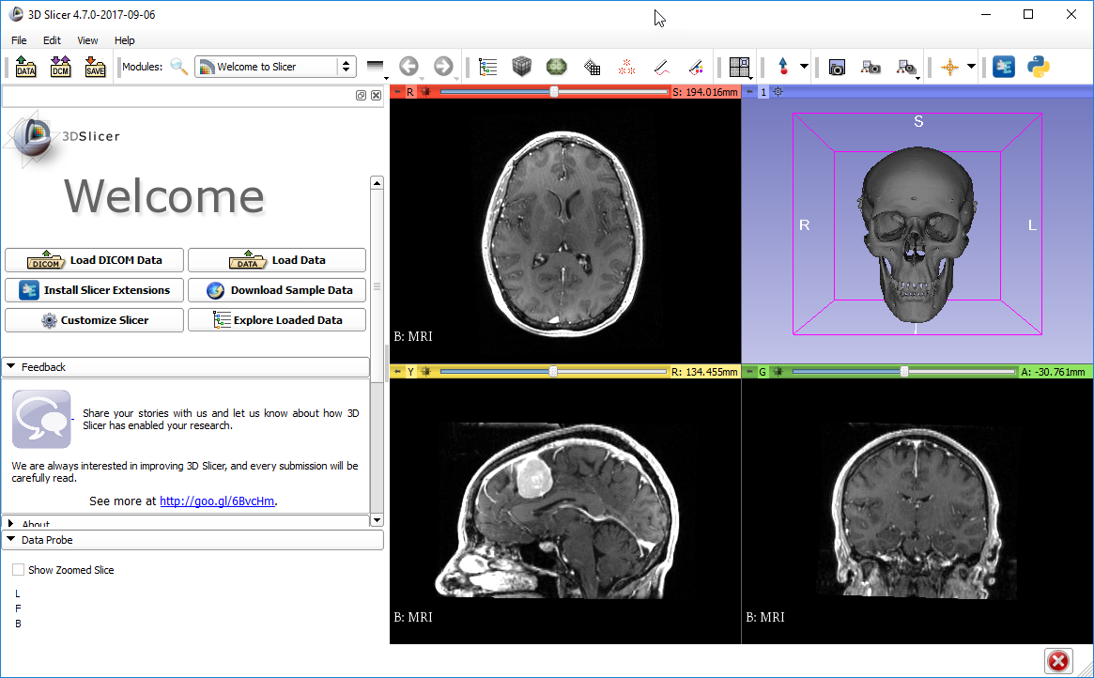
Try 2D interactions
Mouse wheel – change slice
Mouse right button drag – zoom
Mouse middle button drag – panning
Mouse left button drag – intensity windowing
Try 3D interactions
Mouse left button drag – rotations
Mouse wheel – zoom
Mouse middle button drag – panning

Slide 14
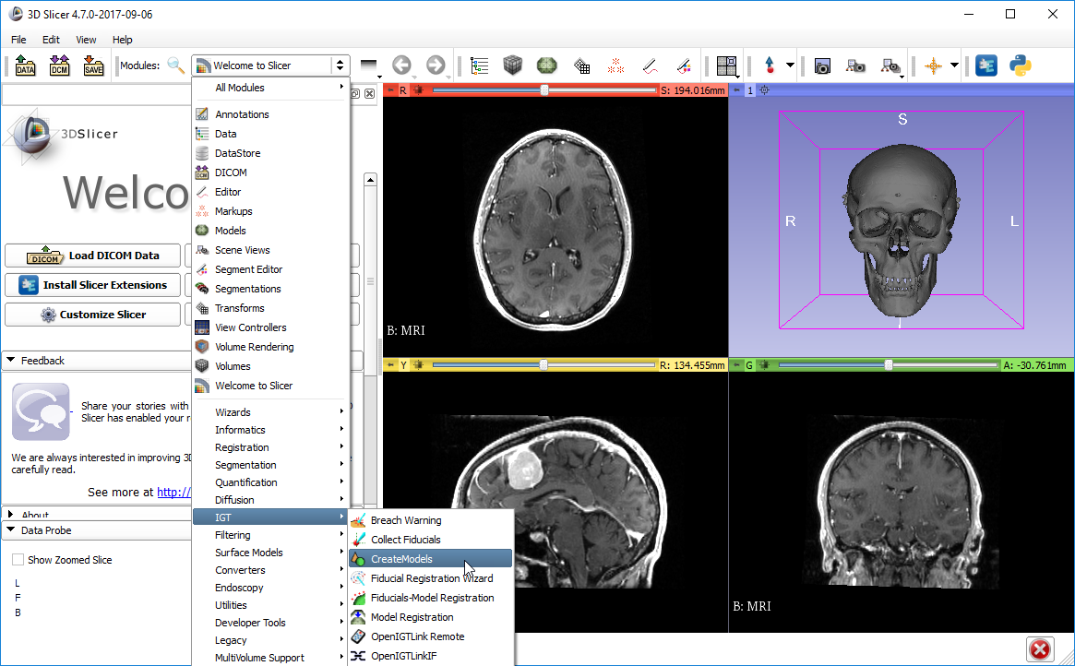
1
2
select

Slide 15
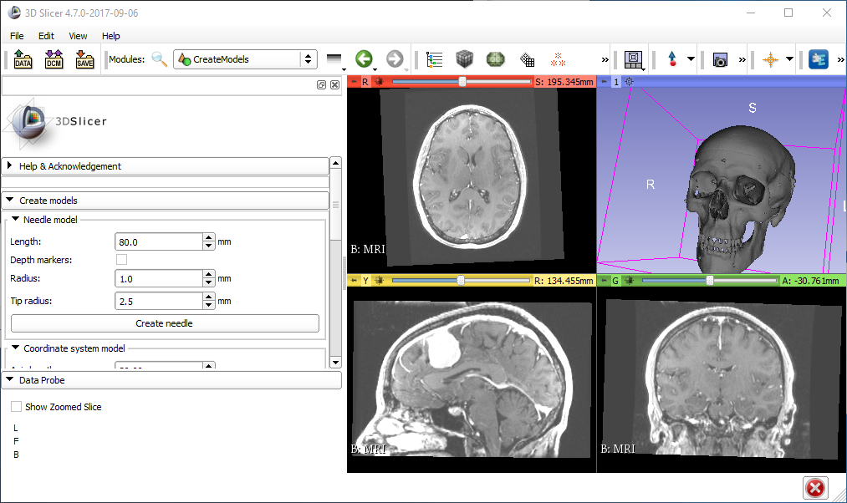
1. see
2. Press once
You won’t see anything after you press this button, but don’t worry.

Slide 16
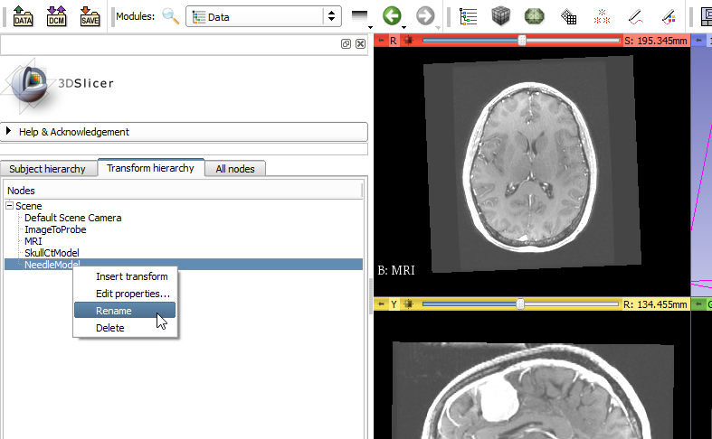
2. see
1
3
4. Right click
4
Rename to “StylusTip”

Slide 17
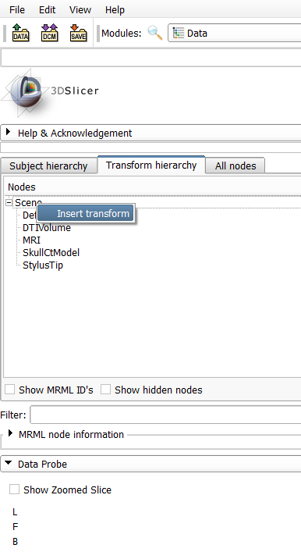
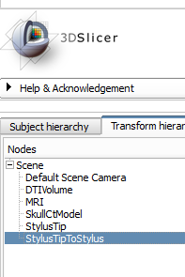
1. Right-click on Scene
2
Double-click to rename new transform

Slide 18
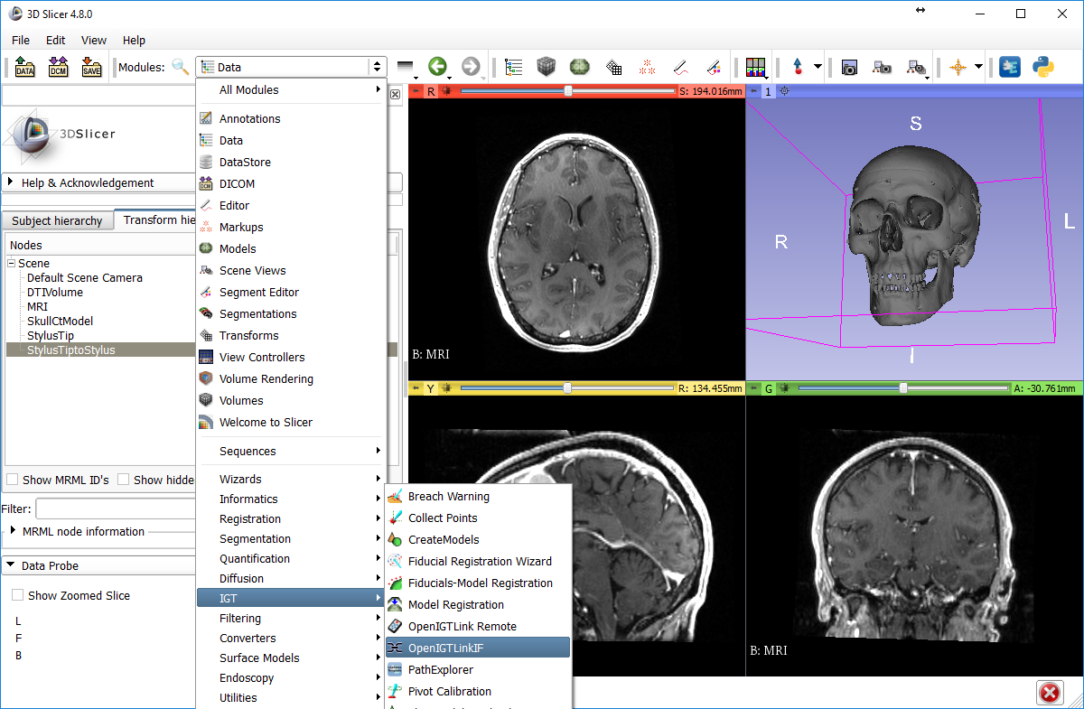
1
2
3

Slide 19
Connect to the PLUS computer
If you are not connected yet…
Connect to SlicerIGT2 WiFi (or SlicerIGT1, but that is slower)
Password: slicerigt
There will be no internet, just local network

Slide 20
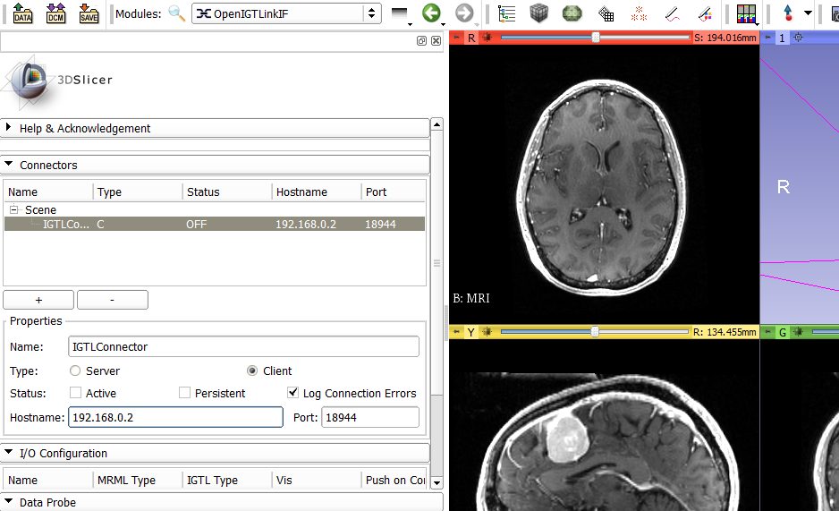
1. see
5. Should turn ON
2
4. Check Active
3. type: 192.168.0.2

Slide 21
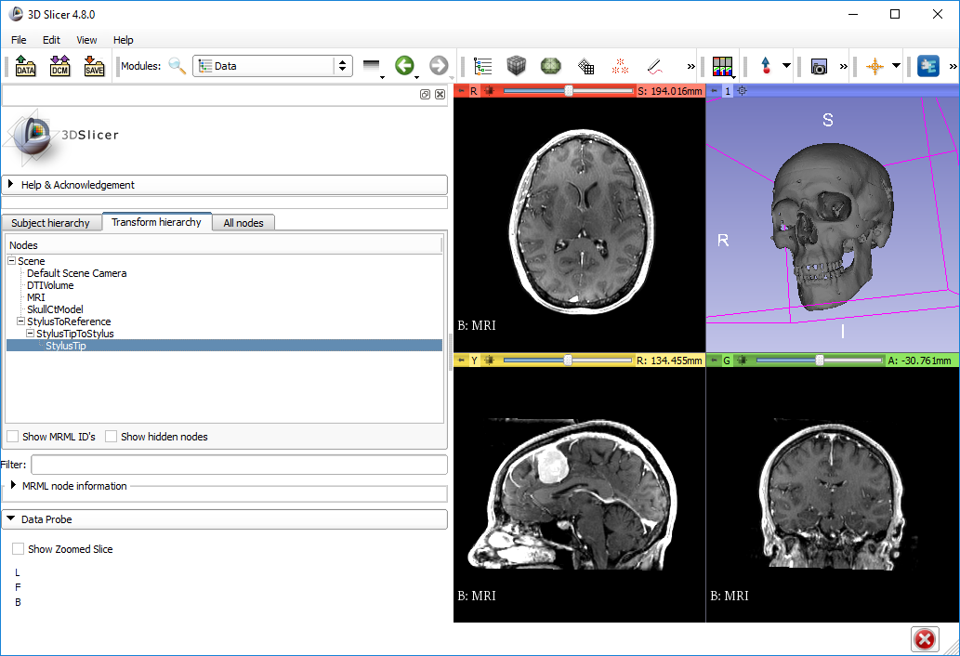
2. see
1
3. Drag and drop nodes to create this transform hierarchy

Slide 22
Checkpoint 01

Slide 23
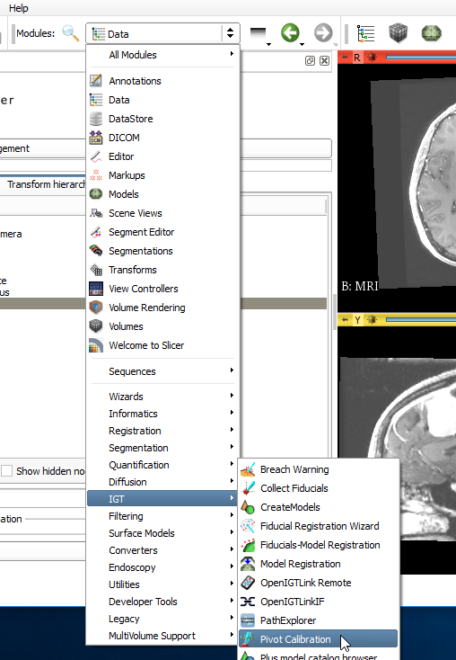
1
2
3. select

Slide 24
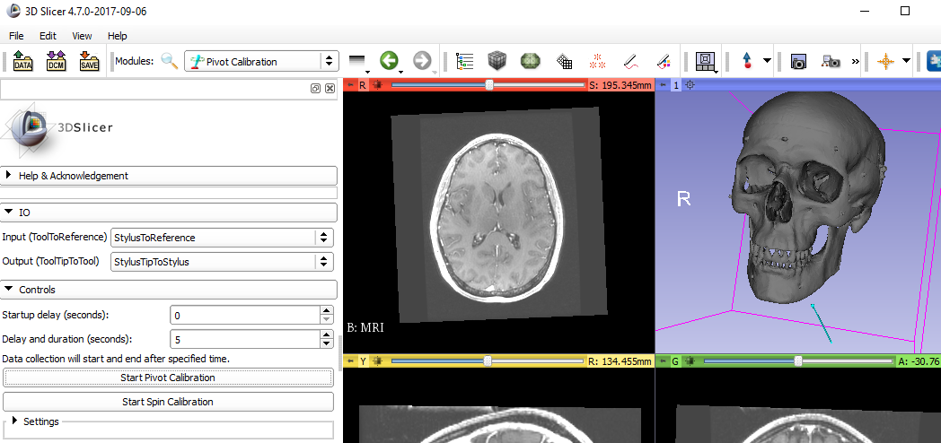
4
1
2
3 (optional)
5. visualize blue stick
WAIT! 6
WAIT! 7
Make sure to start pivot calibration when the physical tool is pivoting
Start pivot calibration again until the blue stick rotates around its tip
8 see
Under 1 mm RMSE is acceptable now

Slide 25
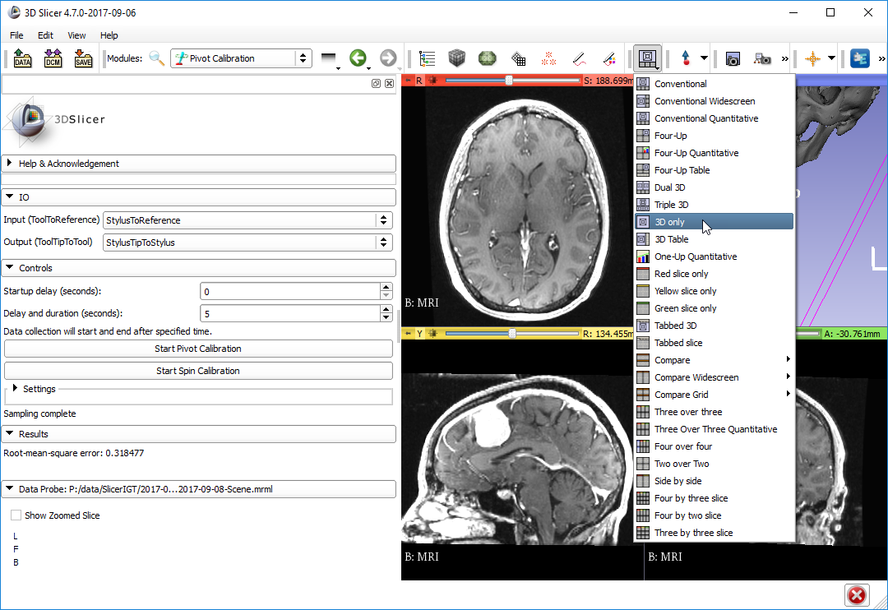
1

Slide 26
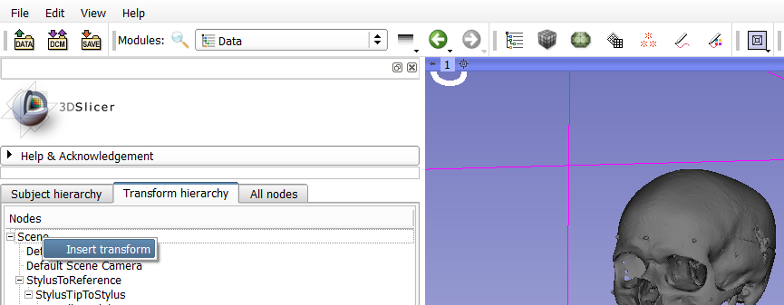
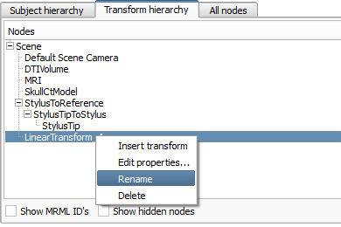
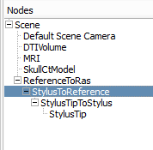
2 see
1
3 right-click
4
6 drag and drop
5 rename to “ReferenceToRas”
RAS is usually our patient coordinate system

Slide 27
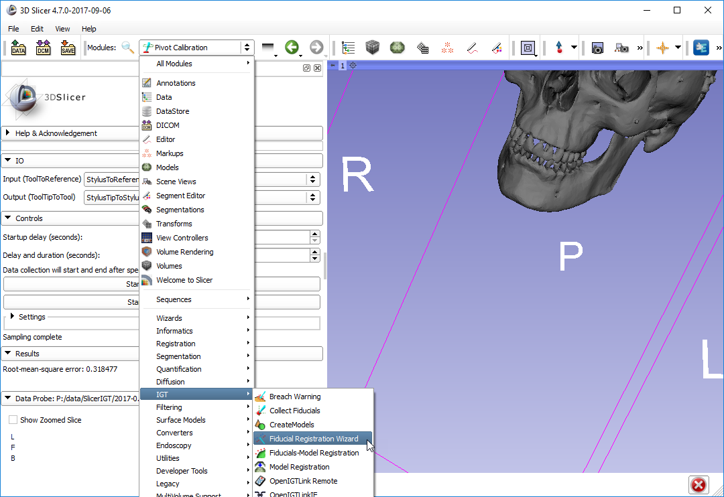
1
2
3. select

Slide 28
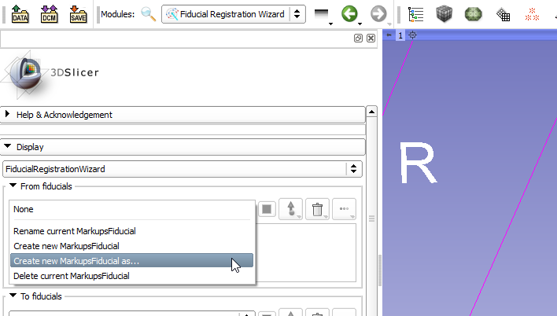
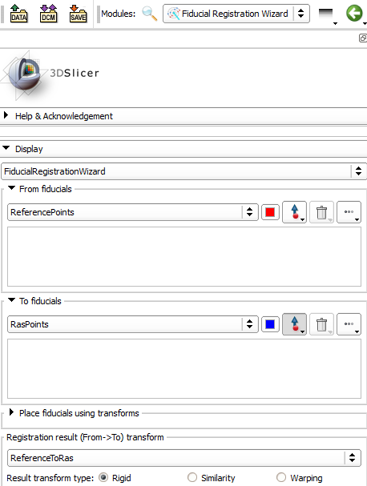
1. see
2
3
New name “ReferencePoints”
4. Create “RasPoints”
5. select

Slide 29
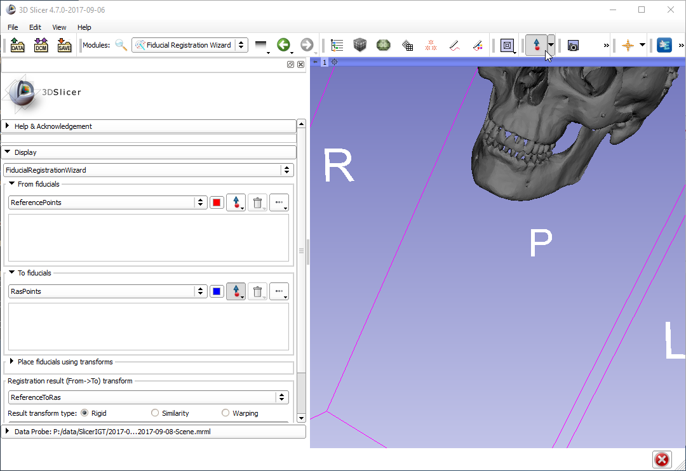
Make sure this button is unchecked when interacting with 3D viewer!
1

Slide 30
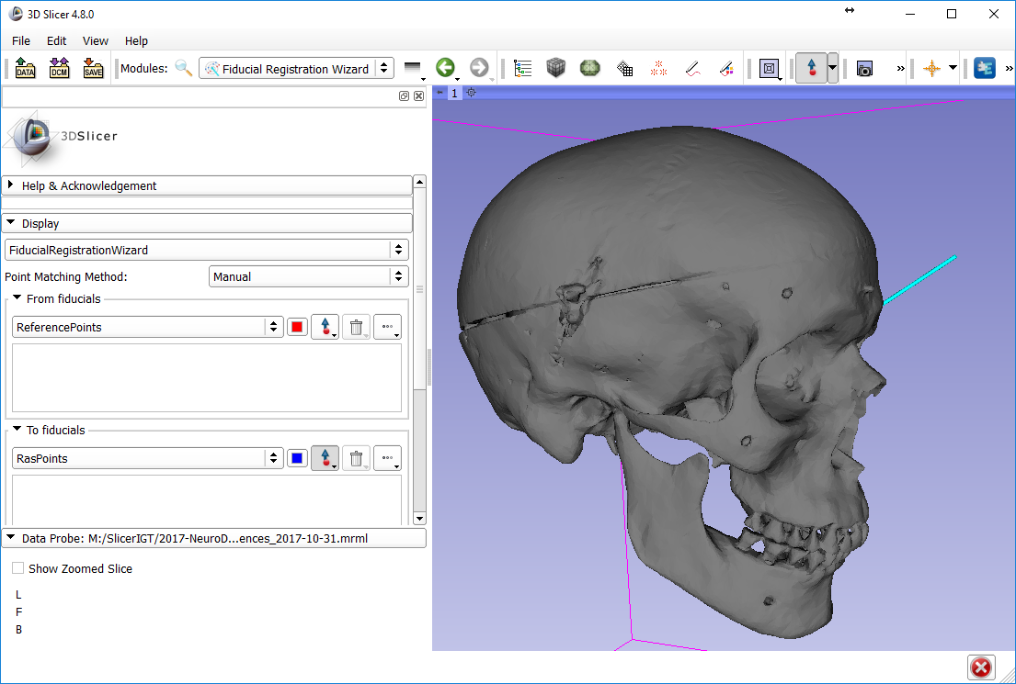
Set up 3D viewer like this
1
3
2

Slide 31
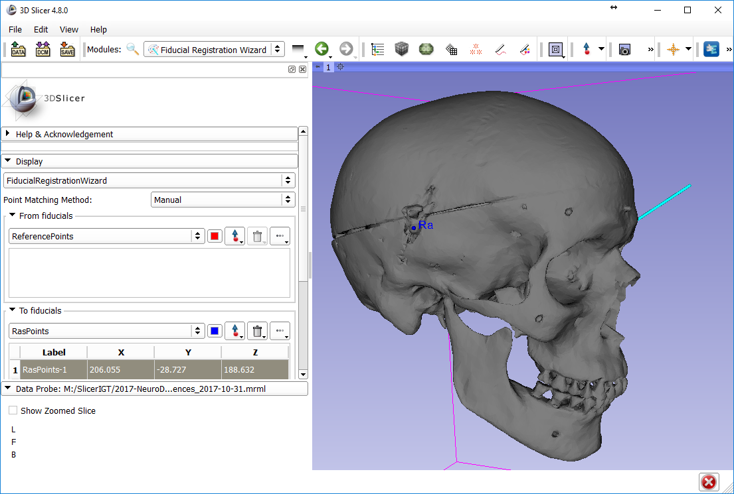
Set up 3D viewer like this
1
3
2

Slide 32
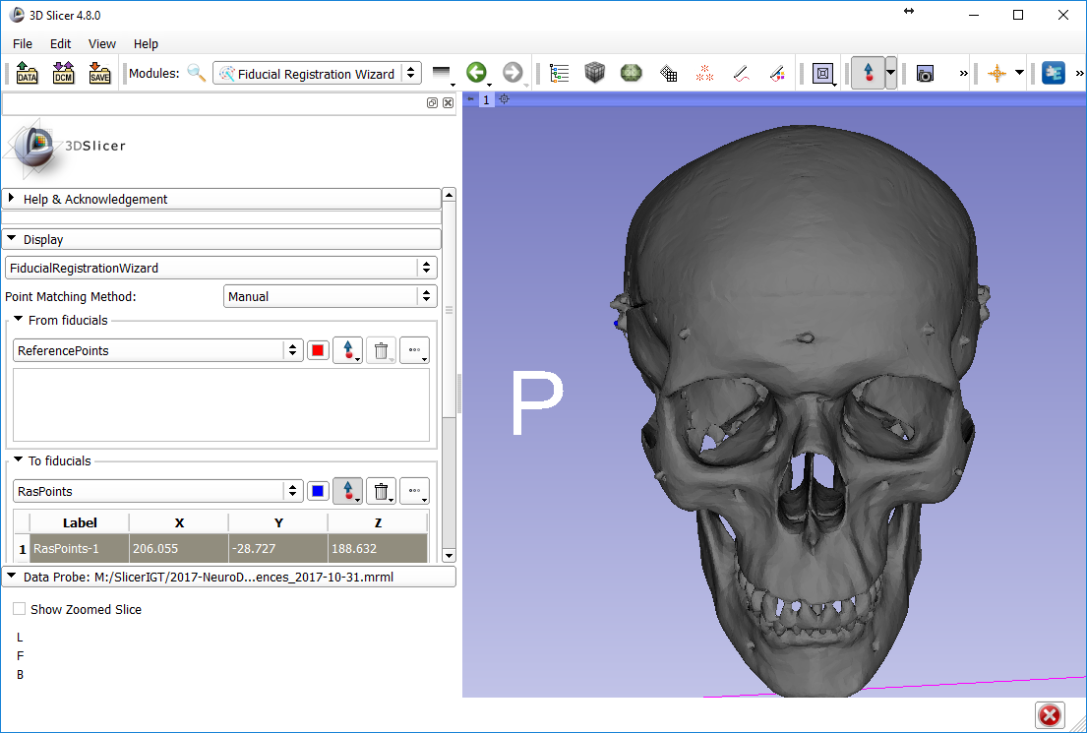
Set up 3D viewer like this
1
3
2

Slide 33
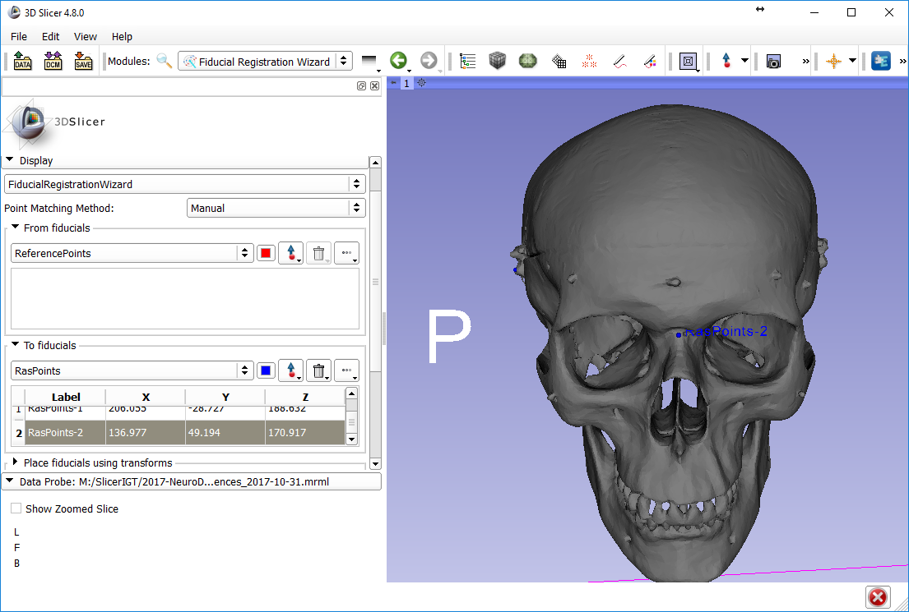
Set up 3D viewer like this
1
3
2

Slide 34
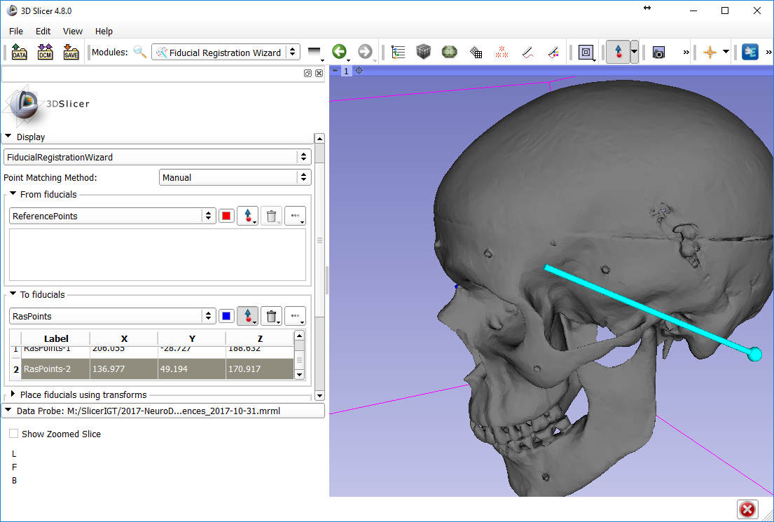
Set up 3D viewer like this
1
3
2

Slide 35
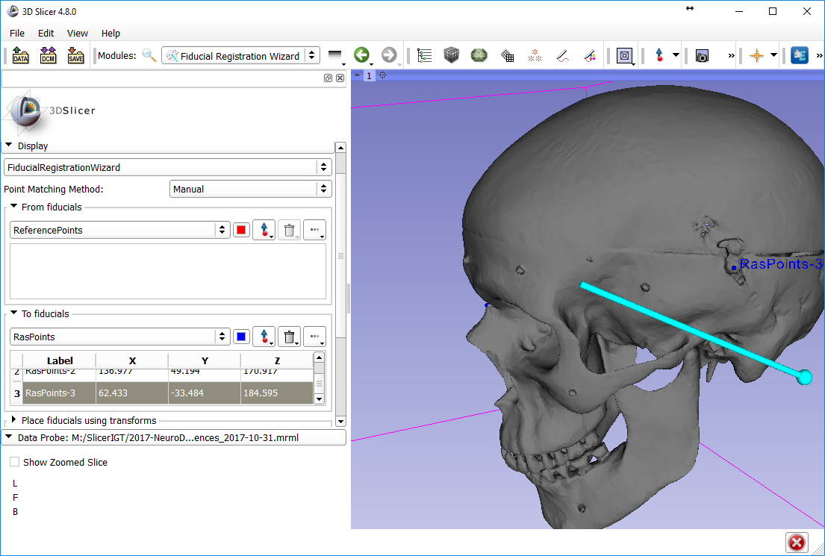
Set up 3D viewer like this
1
3
2
4. See “3”

Slide 36
Checkpoint 02

Slide 37
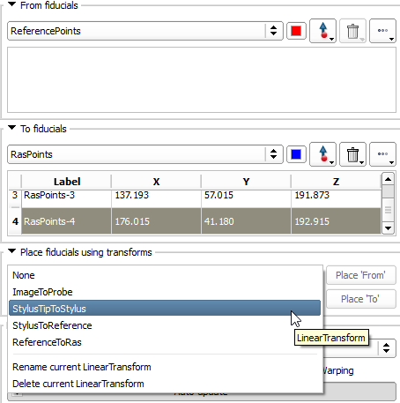
1
When you press
this button (called “From”),
a new point will be created in
this list (called “From”)
2. Select “StylusTipToStylus”
3. Wait for presenter’s signal before pressing this button

Slide 38
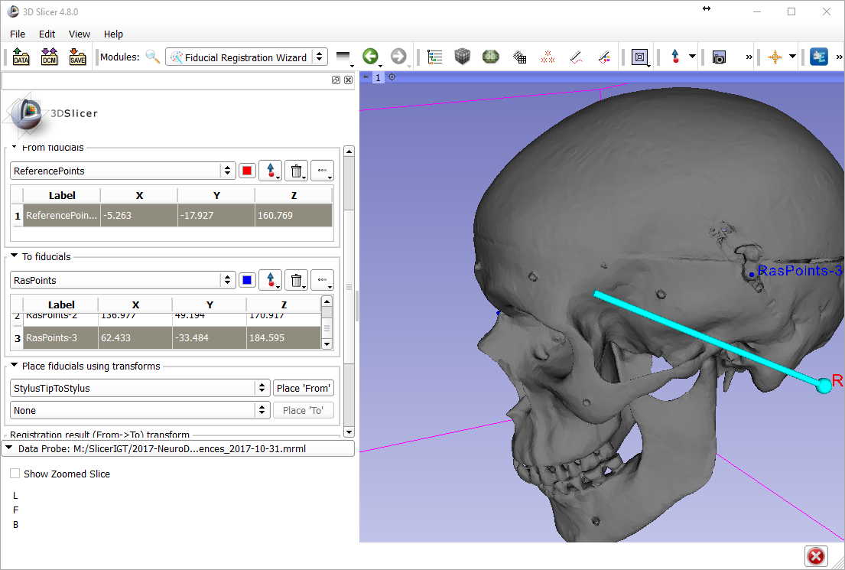

Slide 39
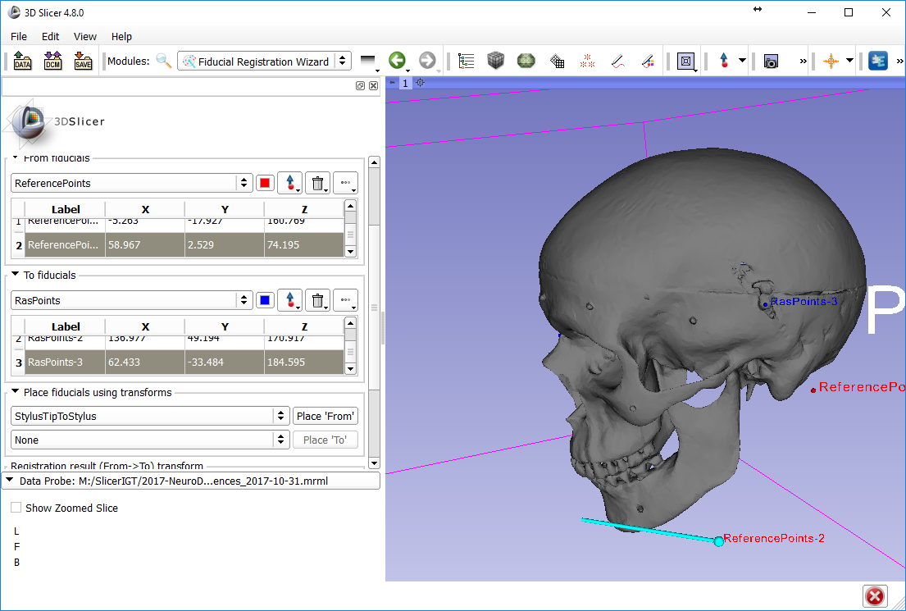

Slide 40
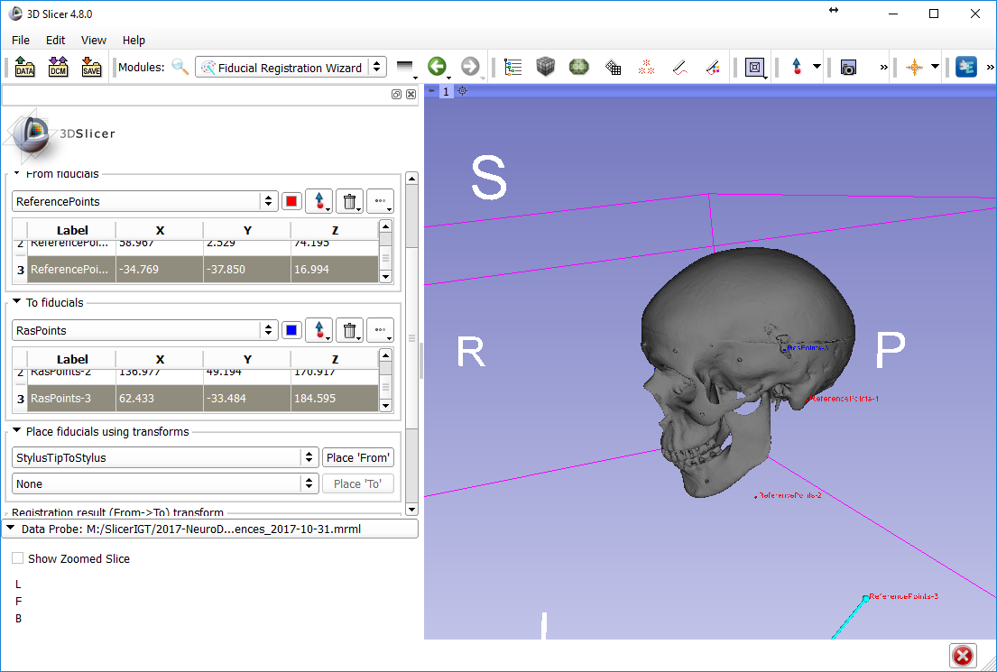

Slide 41
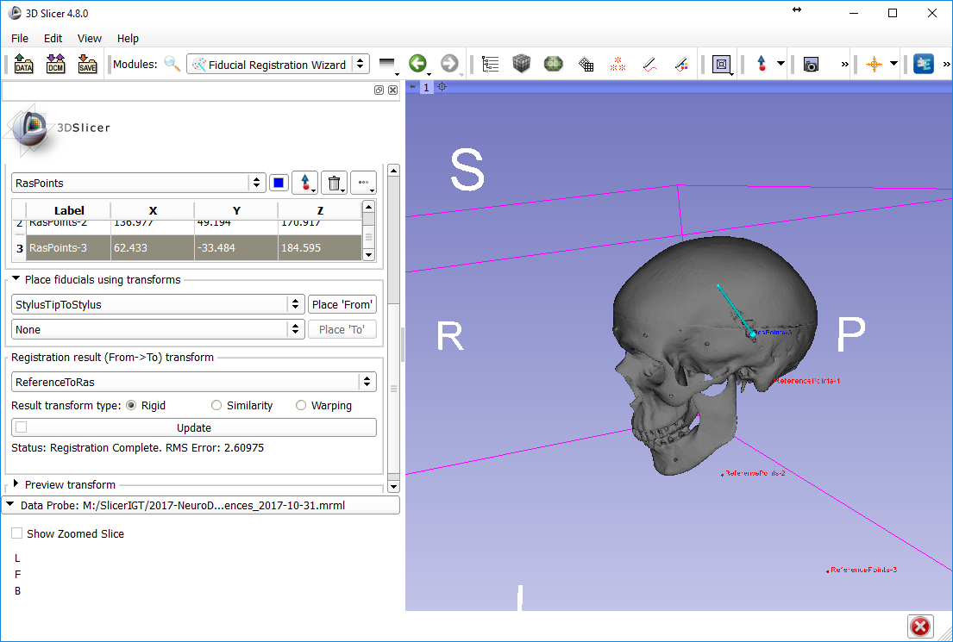
See
select
uncheck
See

Slide 42
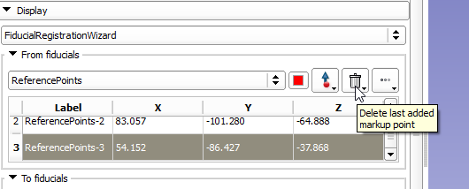
Troubleshooting
How to redo one point
Delete
How to reset registration
2. see
1
Very important to reset before starting a new registration!
3

Slide 43
Checkpoint 03

Slide 44
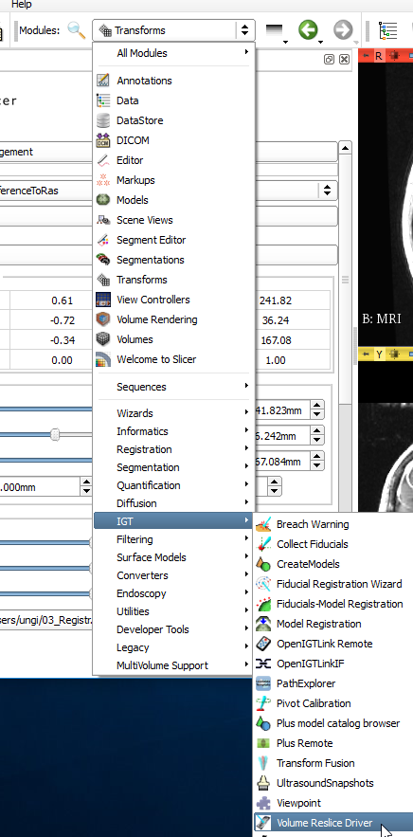
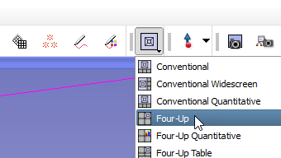
1
2
3. Volume Reslice Driver

Slide 45
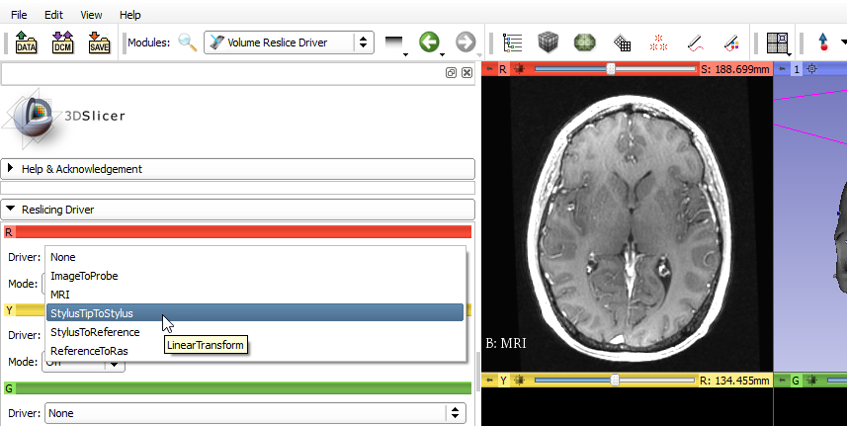
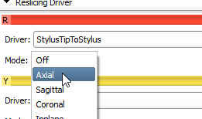
1
2

Slide 46
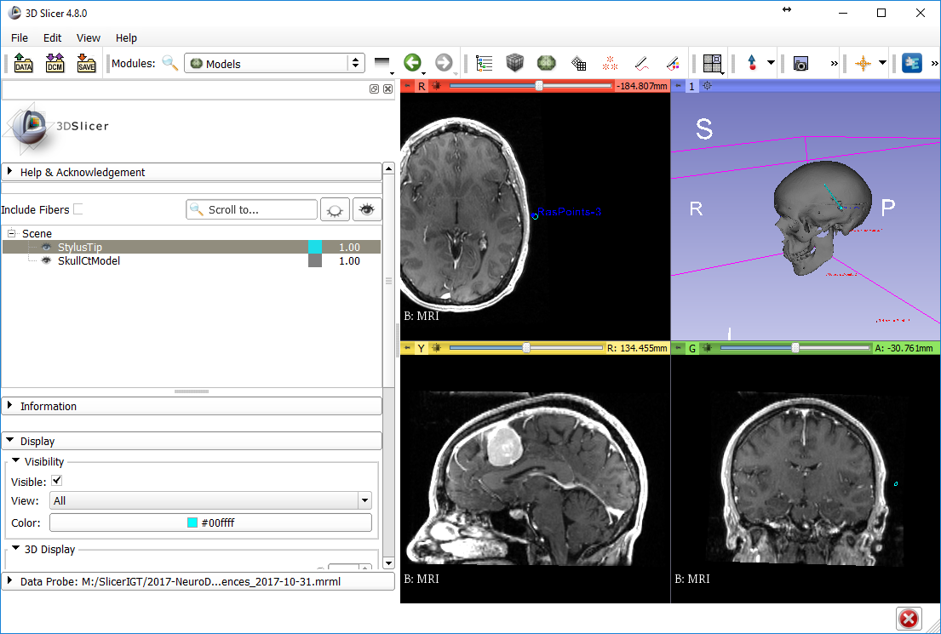
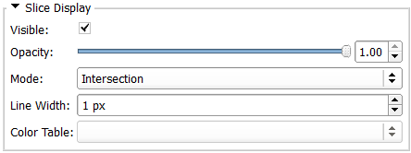
2. see
1
5. see
3
4

Slide 47
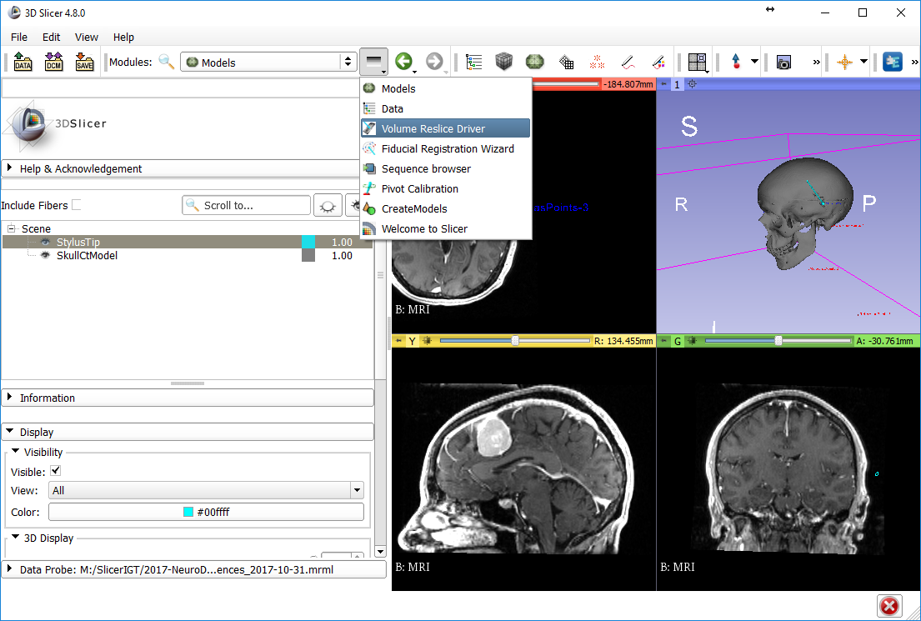
1. module history
2. Back to Volume Reslice Driver

Slide 48
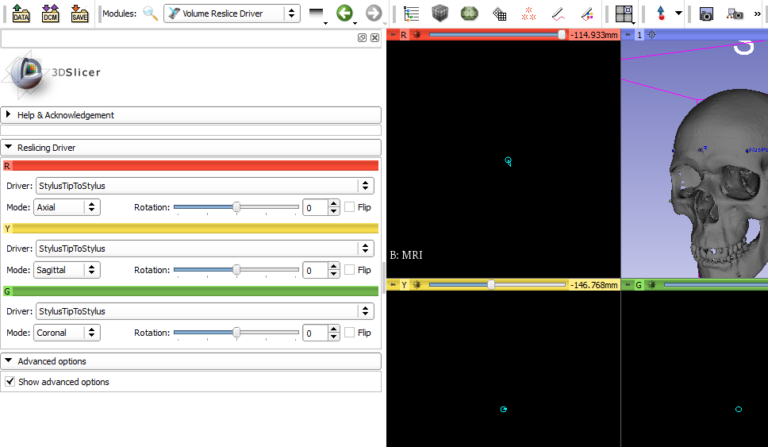

Slide 49
Checkpoint 04

Slide 50
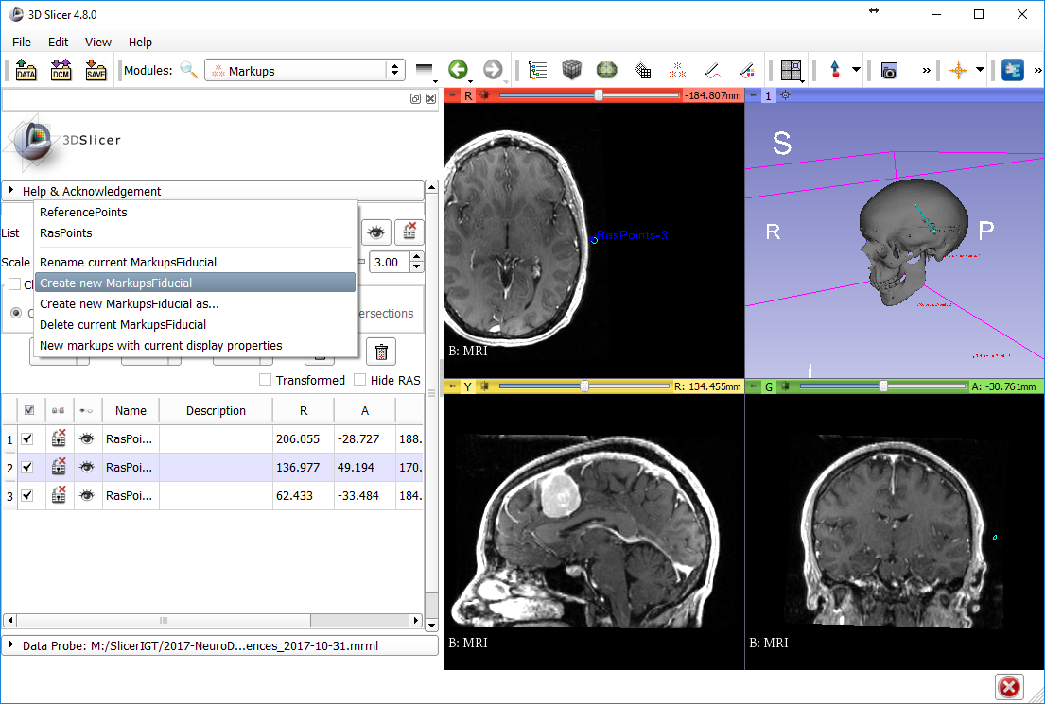
2. see
1
3

Slide 51
1
2. click anywhere
3. double-click each coordinate and set to zero

Slide 52
1
result
2. drag and drop “F” here

Slide 53
1
2. double-click
3
4

Slide 54
1 double-click
2

Slide 55
Tractography Seeding

Slide 56
see result
1
2
3

